Slide 1
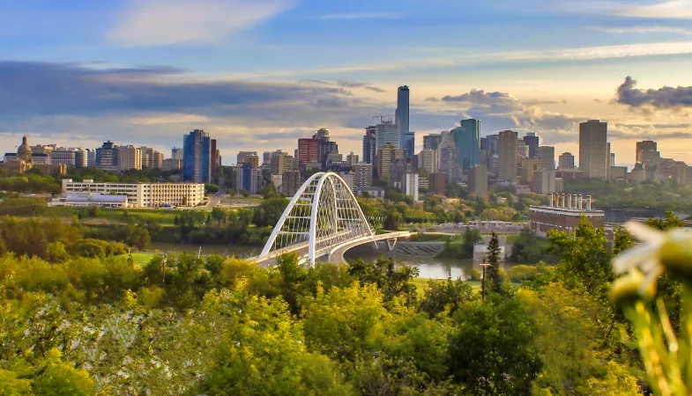
The Battle of Neighborhoods: Alberta

Slide 2
Section 1 Background :Alberta is a province of Canada. With an estimated population of 4,067,175 people as of the 2016,it is Canada's fourth most populous province and the most populous of Canada's three prairie provinces. Problem Statement : As in some people’s minds, Alberta may not as popular as other provinces like BC or Ontario in Canada. However, due to the development in recent years, it is also worth considering living. This project has been designed as someone moving to the Alberta, who is interested in deciding which city in Alberta is more suitable for living(having more convenience facilities like restaurants, shops etc.

Slide 3
Libraries Employed:
Pandas: for manipulating data frames.
Matplotlib: Python plotting module.
BeautifulSoup with Requests: library handles online request, scraping http.
Geocoder: retrieves locational data.
FourSquareAPI: used to identify venues in the area.
Folium: python data visualization library, used to visualize neighborhood clusters on an interactive map.
JSON: library to handle JSON files.
XML: seperates data, allowing XML data to be displayed in plain text.
Scikit Learn: mathmatic library, employed for k-means clustering.

Slide 4
Data&Methodology:
pgeocode
Using data from https://en.wikipedia.org/wiki/List_of_postal_codes_of_Canada:_T to
get list of Borough, neighborhoods, coordinates in Alberta. For the missing data of coordinates, I get it from using pgecode. In this study, we will include every city in Alberta.
Using Foursquare API to identify venues for multiple neighborhoods of Alberta
Using latitude and longitude coordinates of those neighborhoods to plot the map and get the venue data.
Clustering using K-means

Slide 5
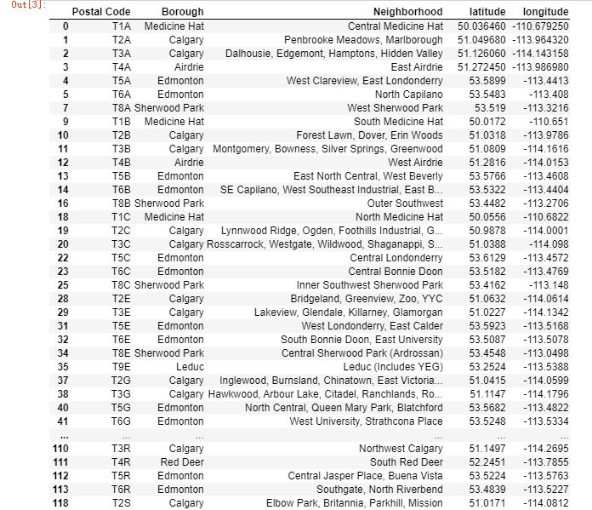
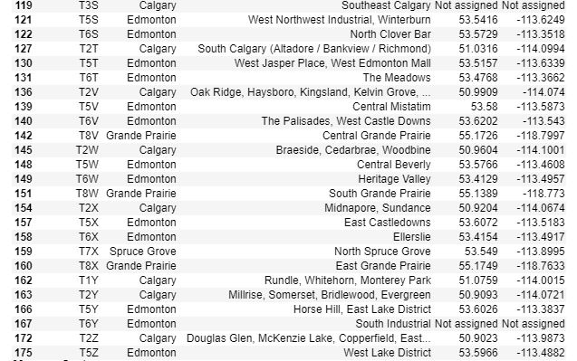
Section 2: Data Sources, Extraction, Cleaning
Scraping the data from website and using pgecode to get the missing data of coordinates.

Slide 6
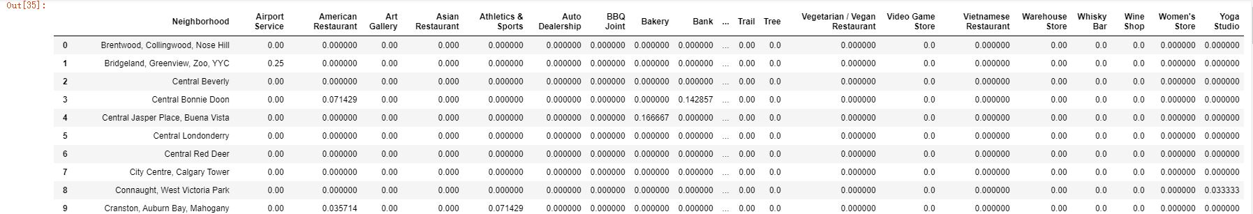
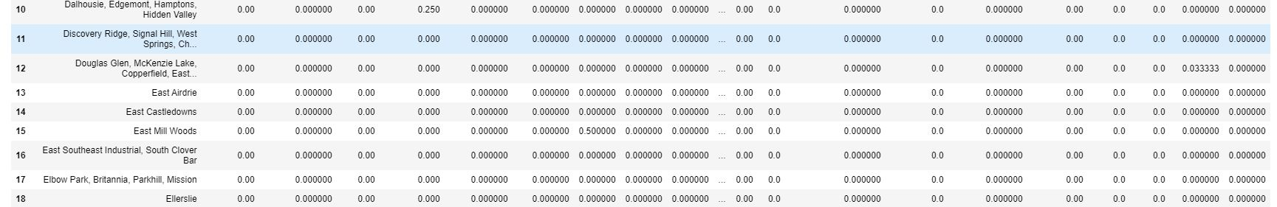
Getting venues for multiple neighborhoods of Alberta

Slide 7
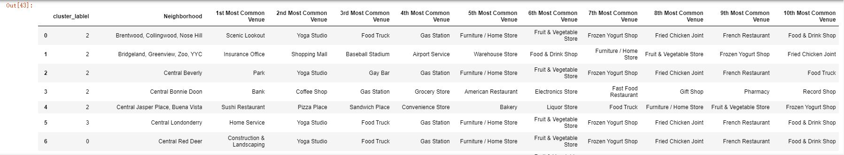
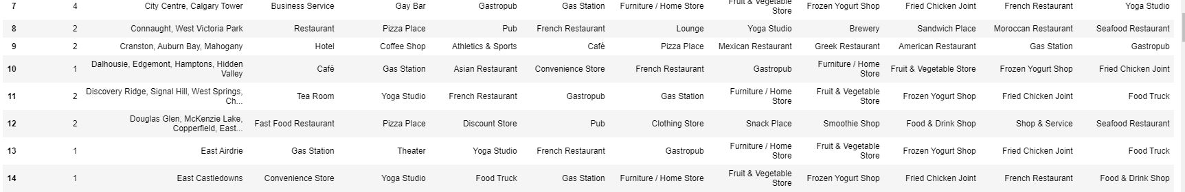
Clustering using k-means

Slide 8
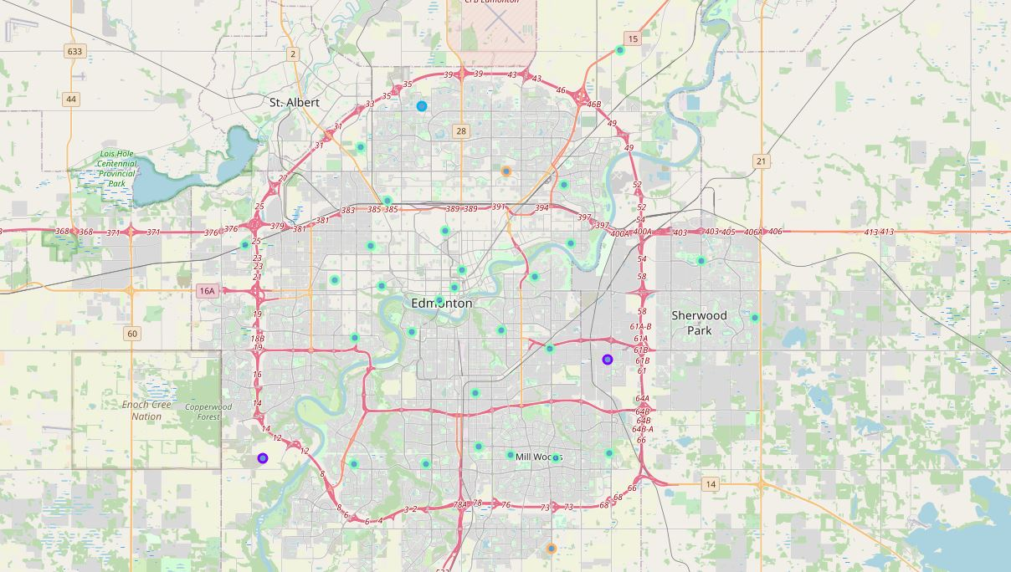
Creating map of Alberta

Slide 9
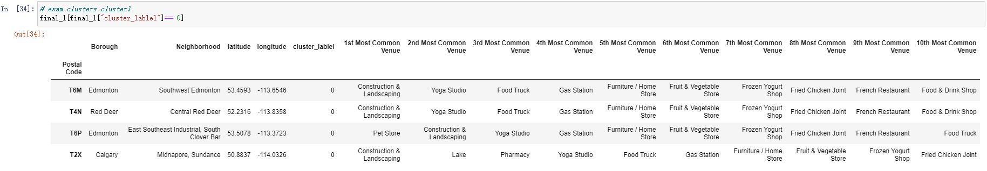
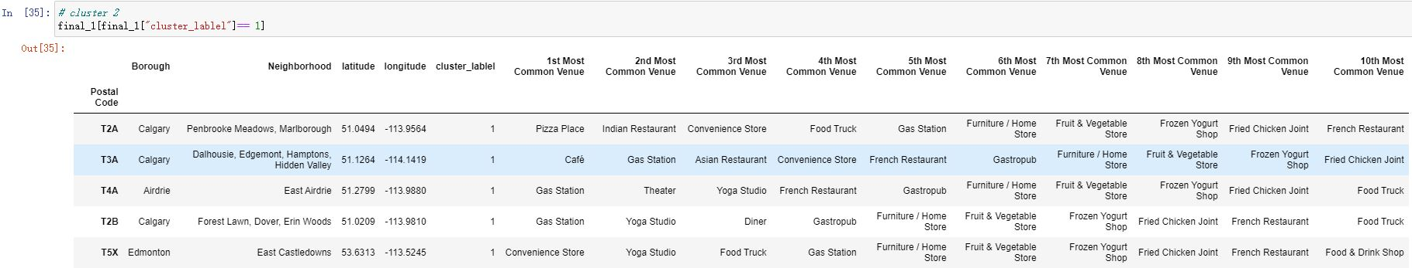
Identifying each cluster

Slide 10
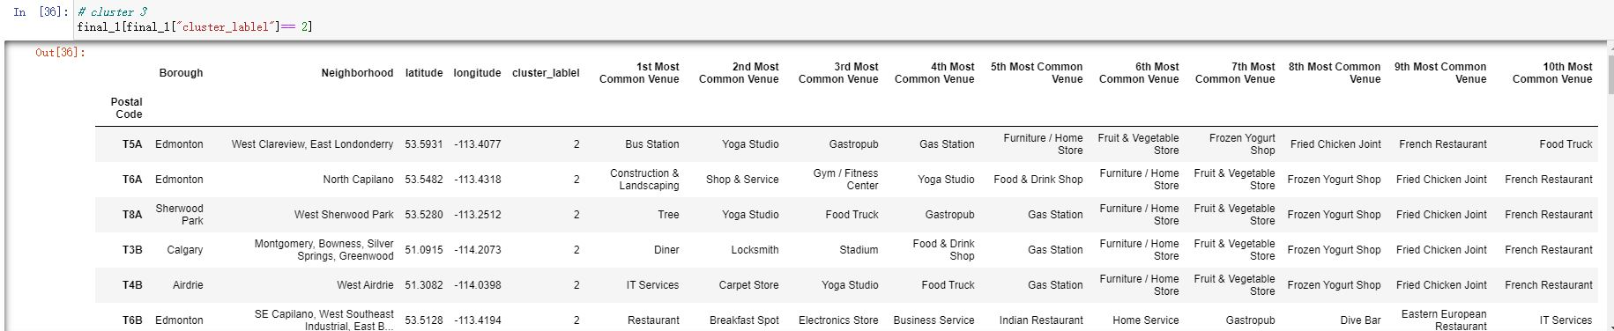
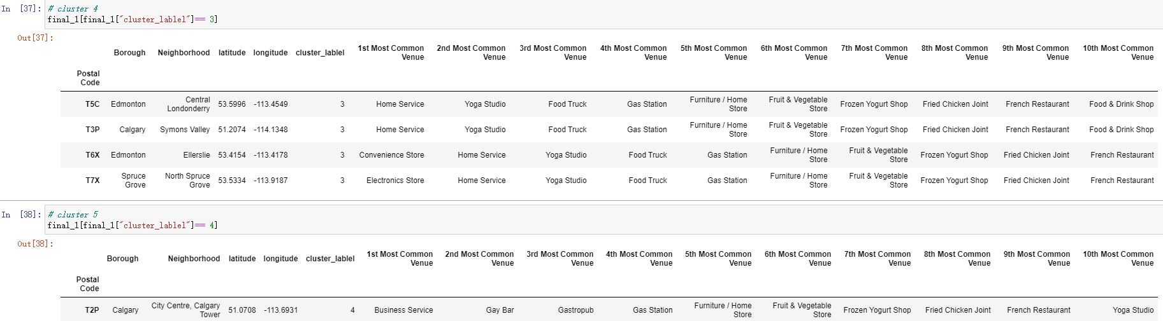

Slide 11
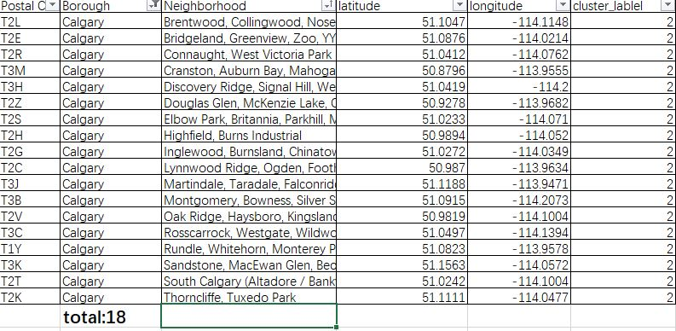
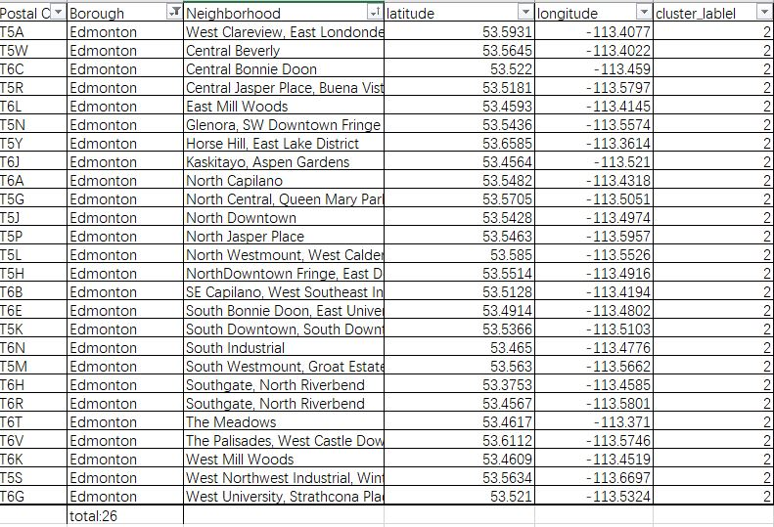
Comparing between 2 most suitable cities

Slide 12
Results&Discussion :
As we can seen from the clustering results, most neighborhoods falls in to cluster 2, which are mostly convenience facilities (restaurants, shops etc. ). Also, in this cluster, most neighborhoods belongs to Edmonton and Calgary. Since Edmonton has more neighborhoods belongs to cluster 2, I think it is a good choice to move to Edmonton compared with Calgary.

Slide 13
Conclusion:
Alberta's capital, Edmonton, is near the geographic center of the province and is the primary supply and service hub for Canada’s crude oil about 290 km south of the capital is Calgary, the largest city in Alberta. Calgary and Edmonton centers Alberta's two census metropolitan areas. The results corresponds to the development of Edmonton. However, people who decides to move to Alberta may have different personal preferences.
Edmonton is a good choice and Calgary is good as well.

